Slide 1
Postpartum Performance Nutrition: Supporting a Female Athlete’s Return to Sport
23084543 Tom Wu BSc Rehab
Notes:
The title of my presentation is Postpartum Performance Nutrition: Supporting a Female Athlete’s Return to Sport. I’m Tom Wu, and today we’ll explore evidence-based nutritional strategies for a 31-year-old female endurance runner who is 10–12 weeks postpartum, breastfeeding, and safely rebuilding her base for 10 km and half-marathon racing.

Slide 2
Contents
1 Athlete profile
2 Current nutrition assessments
3 Energy requirements
4 Macronutrient prescription & Micronutrients
5 Hydration strategy
6 Recovery strategy (4Rs)
7 Ergogenic aids
8 Nutrition across contexts
9 Sample 1-Day menu
10 Summary
11 Reference Slide
Notes:
"Here’s the agenda for today. We’ll cover the athlete profile, current nutrition assessments using the ABCD framework, energy requirements, macro- and micronutrient prescriptions, hydration, the 4R recovery strategy, safe ergogenic aids, nutrition periodization across different contexts, a practical 1-day sample menu, and finally a summary with key takeaways. There’s also a full reference list at the end.

Slide 3
1 Athlete profile - basic information
Age: 31 years old [1] Weight: 66.68kg[4] Height: 161 cm[5]
Gender: female
Sport: endurance running (10 km / half-marathon level)
Training cycle: Early return-to-training phase (10–12 weeks postpartum) — building base conditioning before entering pre-season race prep
[1]Dietz, P., Legat, L., Sattler, M.C. et al. Triple careers of athletes: exploring the challenges of planning a pregnancy among female elite athletes using semi-structured interviews. BMC Pregnancy Childbirth 22, 643 (2022).
[4]Jiang, J., Li, C,el al. (2024) ‘Relationship between abnormal pelvic floor electromyography and obstetric factors in postpartum women: a cross-sectional study’, BMC Women’s Health, 24, p. 239.
[5]Baattaiah BA, Zedan HS,et al. Physical activity patterns among women during the postpartum period: an insight into the potential impact of perceived fatigue. BMC Pregnancy Childbirth. 2022 Sep 3;22(1):678.
Notes:
On these slides, we profile our 31-year-old female endurance runner. She’s 161 cm tall, currently 66.68 kg with a BMI of 25.7—slightly above her pre-pregnancy weight of around 60–62 kg, which is normal postpartum weight retention. She’s in the early return-to-training phase, focusing on base conditioning before race preparation.

Slide 4
1 Athlete profile – body composition & lifestyle factors
Factor | Details
Body composition | Slight postpartum weight retention; lean athletic baseline prior to pregnancy [2]
Sleep | Interrupted sleep (breastfeeding schedule + infant night waking) — ~5–6 hrs fragmented sleep/night
Schedule | Training windows limited due to childcare; mix of stroller running, home strength sessions, and supervised runs
Travel | No major travel yet — local training only
Medical clearance | Cleared for progressive return to exercise; pelvic floor physio input
Notes:
Key lifestyle challenges include fragmented sleep—only 5–6 hours per night due to breastfeeding and infant wake-ups—limited training windows because of childcare, and no major travel yet. She has medical clearance for progressive loading and is working with pelvic floor physiotherapy.
These changes directly influence nutritional needs by increasing carbohydrate requirements for energy restoration, protein needs for lean mass recovery, and micronutrient needs for iron and bone metabolism. Therefore, her demographic and postpartum profile guides the overall nutrition plan, ensuring energy availability is protected during early return to training.

Slide 5
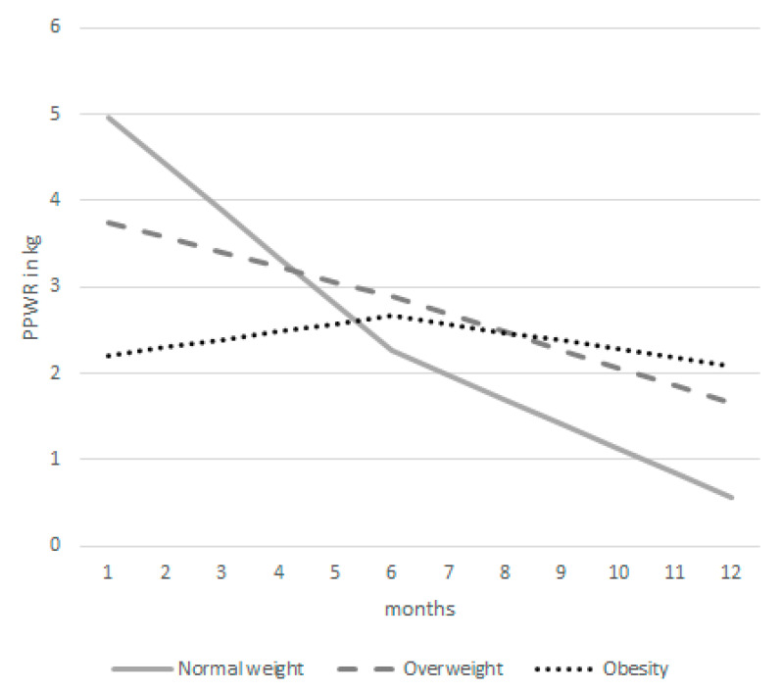
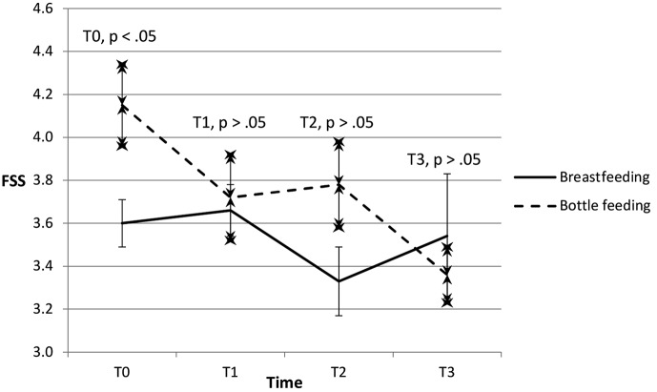
1 Athlete profile – body composition & lifestyle factors
The estimated evolution of postpartum weight retention among women with normal weight, overweight and obesity based on the multivariate mixed model (N = 524 at 6 weeks, N = 395 at 6 months, N = 311 at 12 months postpartum).[2]
Evolution of fatigue from T0 to T3 for the breastfeeding and bottle feeding groups. Fatigue Severity Scale (FSS); values are mean ± standard error[3]
[2]Bijlholt, Margriet et al. “Evolution of Postpartum Weight and Body Composition after Excessive Gestational Weight Gain: The Role of Lifestyle Behaviors-Data from the INTER-ACT Control Group.” International journal of environmental research and public health vol. 18,12 6344. 11 Jun. 2021.
[3]Mariman, An et al. “Longitudinal assessment of sleep and fatigue according to baby feeding method in postpartum women: a prospective observational study.” BMC pregnancy and childbirth vol. 24,1 529. 12 Aug. 2024.
Notes:
Postpartum weight retention and increased fatigue levels are well-documented, especially in breastfeeding women (Bijlholt et al., 2021; Mariman et al., 2024). These factors elevate the risk of low energy availability and slow training adaptation. This evidence justifies a strategy that prioritises higher carbohydrate intake, structured protein distribution, and micronutrient restoration. By linking physiological changes to targeted nutrition adjustments, we can support her return to endurance training while minimising RED-S risk.

Slide 6
2 Current nutrition assessments
A - Anthropometry
B - Biochemistry
C - Clinical history
D - Dietary intake
Notes:
We’ll use the classic ABCD nutrition assessment framework: Anthropometry, Biochemistry, Clinical history, and Dietary intake.

Slide 7
A - Anthropometry
facts | data
Age | 31 years
Height | 161 cm
Weight | 66.68 kg
BMI | 25.7 kg/m²
Pre-pregnancy est. weight | ~60–62 kg
Body composition (expected) | ↓ Lean body mass and increase bone density change in stages
12 weeks postpartum is in the stage of a slight increase in body fat and muscle mass to be restored; Focus on functional recovery rather than rapid weight loss, following progressive training & reasonable energy supply.
Notes:
At 12 weeks postpartum, the goal is functional recovery, not rapid weight loss. Evidence shows that insufficient energy intake at this stage impairs lactation, hormonal recovery, and training progress (Holtzman & Ackerman, 2021). Therefore, maintaining adequate caloric intake is essential to support both baseline metabolism and training load. This informs our calculated energy targets and the recommendation to avoid caloric restriction.

Slide 8
B - Biochemistry
facts | Focus | reason
Ferritin / Iron | may be low [6] | High iron requirements during pregnancy and postpartum periods further increase the risk of endurance training
Vitamin D | need to be restored [7] | It plays an important role in bone recovery and immunity
Calcium | key Minerals [7] | Lactation + Bone Density Recovery Needs
TSH / Thyroid profile | TSH fluctuations [8] | Postpartum thyroid loss can easily affect energy and weight
[6]Pengelly, Michael et al. “Iron deficiency, supplementation, and sports performance in female athletes: A systematic review.” Journal of sport and health science, vol. 14 101009. 12 Nov. 2024, [7]Holtzman B, Ackerman KE. Recommendations and Nutritional Considerations for Female Athletes: Health and Performance. Sports Med. 2021;51(Suppl 1):43-57. [8]Jin, Ying et al. “Prevalence of thyroid dysfunction in postpartum women with suboptimal iodine and selenium and adequate iron status.” Clinical endocrinology vol. 95,6 (2021): 873-881.
Notes:
Postpartum women frequently present low iron stores, thyroid fluctuations, and micronutrient deficiencies (Pengelly et al., 2024; Jin et al., 2021). For endurance athletes, these deficiencies have direct performance implications: reduced VO2 max, increased fatigue, impaired oxygen transport, and poor recovery. Therefore, biochemistry findings strongly justify prioritising iron-rich foods, monitoring ferritin levels, supporting thyroid health, and ensuring adequate vitamin D and calcium intake.

Slide 9
C - Clinical history
facts | details
Delivery type | Hypothesis: Vaginal delivery (no complications) / minor birth canal injury
Menstrual function | may not have recovered yet
Musculoskeletal | Attention should be paid to core stability, pelvic alignment, and lumbopelvic control
Fatigue & sleep | Newborn care → Fragmented sleep, fatigue
Injury risk | The postpartum ligament relaxation period requires gradual recovery
Notes:
Assuming a vaginal delivery with no major complications, we pay attention to core stability, pelvic alignment, lingering ligament laxity, and high fatigue from newborn care.

Slide 10
D - Dietary intake
Insufficient energy intake: risk: REDS(Relative Energy Deficiency in Sport) / decreased lactation / poor recovery
Inadequate protein distribution (4 meal allocations not reached)
Carb deficiency: affects training recovery & milk production
Low intake of iron, calcium, and vitamin D. Lack of hydration
(postpartum breastfeeding + exercise)
Notes:
Dietary assessment reveals insufficient energy availability, low carbohydrate intake, uneven protein distribution, and inadequate micronutrients. These deficiencies align with known postpartum risks—RED-S, low milk production, impaired neuromuscular recovery, and reduced training capacity. This evidence directly informs the macronutrient and micronutrient prescriptions that follow, ensuring each recommendation addresses a clearly identified nutritional gap.

Slide 11
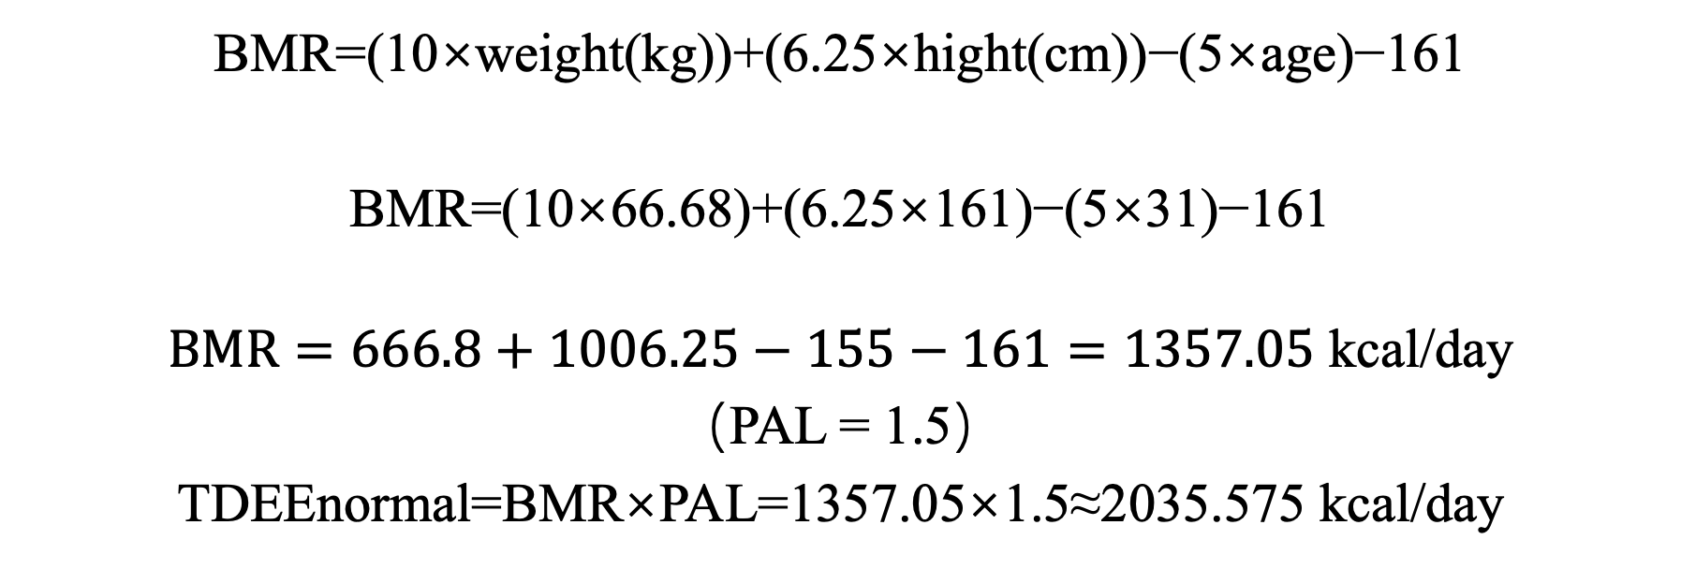
3 Energy requirements – Harris-Benedict
BMR=(10×weight(kg))+(6.25×hight(cm))−(5×age)−161
BMR=(10×66.68)+(6.25×161)−(5×31)−161
$$BMR=666.8+1006.25−155−161=135\text{7.05} \text{kcal}\text{/}\text{day}$$
（PAL = 1.5）
TDEEnormal​=BMR×PAL=1357.05×1.5≈2035.575 kcal/day
Notes:
Using the Harris-Benedict equation for women
With the result of 2000kal/day

Slide 12
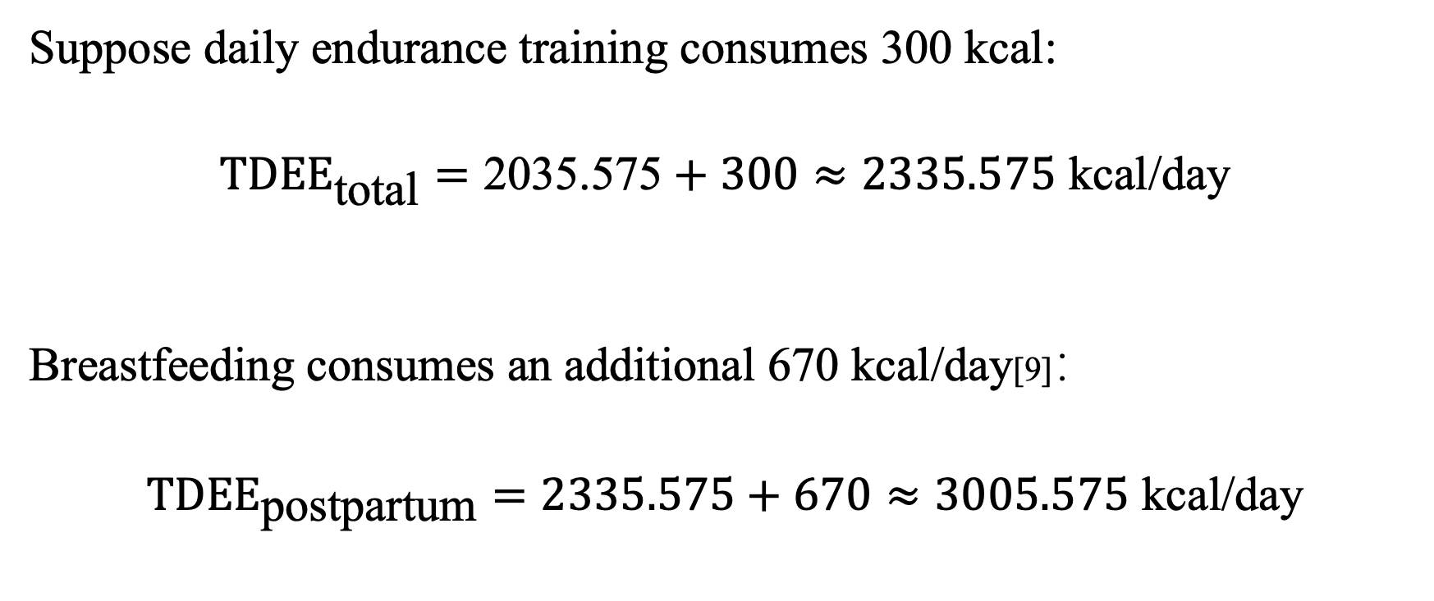
3 Energy requirements – Harris-Benedict
Suppose daily endurance training consumes 300 kcal:
$$TDEE_{\text{total}}=\text{203}\text{5}\text{.}\text{5}\text{75}+300≈2335.575 \text{kcal}\text{/}\text{day}$$
Breastfeeding consumes an additional 670 kcal/day[9]：
$$TDEE_{\text{postpartum}}=2335.575+670≈\text{3005.575} \text{kcal}\text{/}\text{day}$$
[9]Dewey, K G. “Energy and protein requirements during lactation.” Annual review of nutrition vol. 17 (1997): 19-36. doi:10.1146/annurev.nutr.17.1.19
Notes:
For further consideration, we think about the training process and lactation as two things that also require a lot of energy. Here, we assume the breastfeeding cost approximately 670 kcal/day and 300 kcal/day for the daily training process, based on the evidence-based research.

Slide 13
4 Macronutrient prescription & Micronutrients
Carbohydrate
Protein
Fat

Slide 14
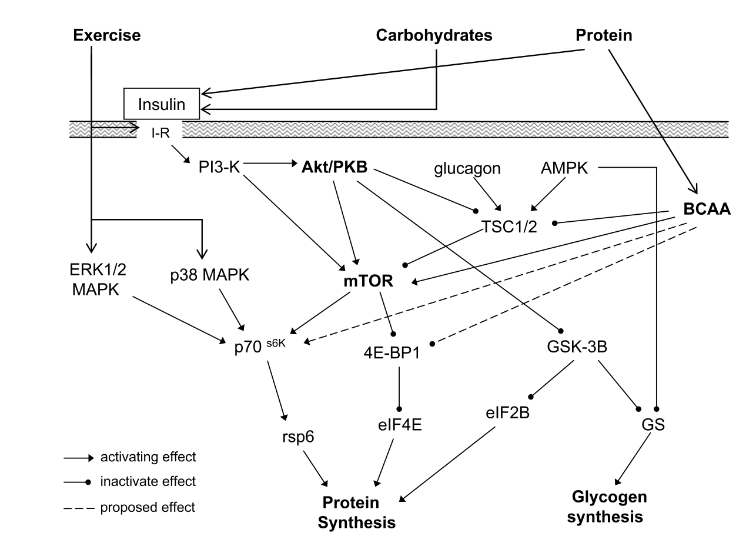
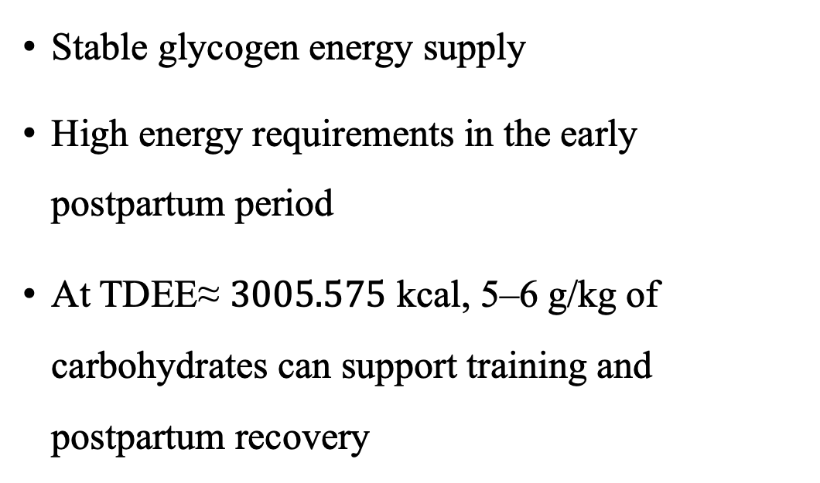
Carbohydrate
Stable glycogen energy supply High energy requirements in the early postpartum period At TDEE≈ $\text{300}\text{5}\text{.}\text{5}\text{75} \text{kcal}$, 5–6 g/kg of carbohydrates can support training and postpartum recovery
[10] Burke, L. M., Hawley, J. A., Wong, S. H., & Jeukendrup, A. E. (2011). Carbohydrates for training and competition. Journal of sports sciences, 29 Suppl 1, S17–S27.
[11]Butte, N. F., & King, J. C. (2005). Energy requirements during pregnancy and lactation. Public health nutrition, 8(7A), 1010–1027.
Notes:
Carbohydrate requirements are intentionally set at 5–6 g/kg/day to maintain glycogen availability. Postpartum fatigue is significantly elevated, and evidence shows carbohydrates help attenuate fatigue perception and support milk production. Therefore, carbohydrate timing (before and after runs) is essential to prevent performance decline and protect lactation.

Slide 15
Recommend
Meals: Oats + fruit, brown rice, potatoes,
Snacks: Banana, yogurt + cereal, whole grain bread
Long-run First 2–3 hours: 1–2 g/kg Carbs
30–60 minutes after the run: 1 g/kg Used for sugar supplementation
5–6 g/kg/day → ≈ 333–400 g/day（Based on 66.68 kg）
[12]Thomas, D Travis et al. “Position of the Academy of Nutrition and Dietetics, Dietitians of Canada, and the American College of Sports Medicine: Nutrition and Athletic Performance.” Journal of the Academy of Nutrition and Dietetics vol. 116,3 (2016): 501-528.

Slide 16
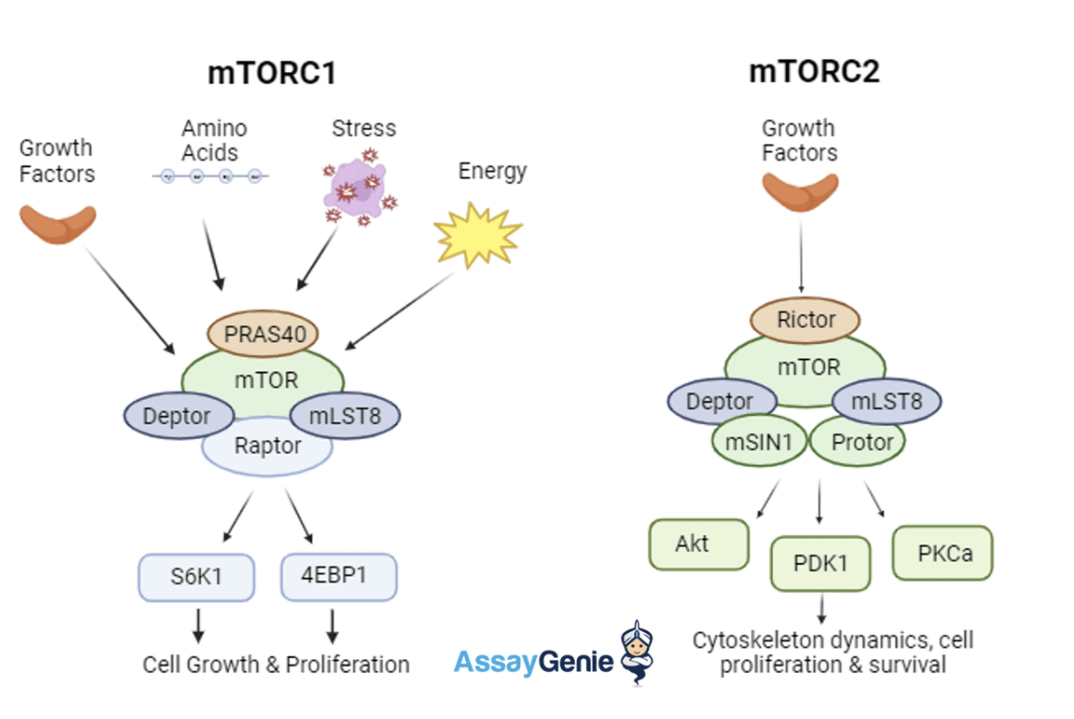
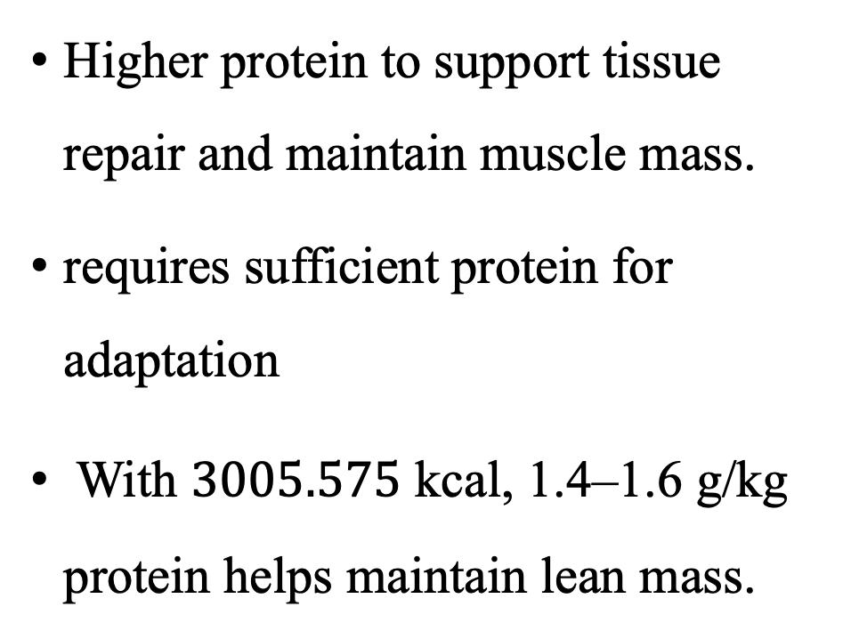
Protein
Higher protein to support tissue repair and maintain muscle mass.
requires sufficient protein for adaptation With $\text{300}\text{5}\text{.}\text{5}\text{75} \text{kcal}$, 1.4–1.6 g/kg protein helps maintain lean mass.
[13]Jäger R, Kerksick CM, Campbell BI, et al. International Society of Sports Nutrition Position Stand: protein and exercise. J Int Soc Sports Nutr. 2017;14:20.
Notes:
Protein intake of 1.4–1.6 g/kg/day supports postpartum muscle mass restoration and counters the catabolic environment associated with sleep disruption and hormonal fluctuations. Evidence suggests distributing protein evenly enhances muscle protein synthesis, which is critical in the return-to-training phase

Slide 17
Recommend
Eggs, chicken breast, fish, lean beef, tofu, Greek yoghurt
Snacks: Protein powder shakes, milk, cheese, soy milk
Post-run: 20–25 g protein within 1 hour
Before bed (optional): Casein yoghurt promotes muscle recovery at night
1.4–1.6 g/kg/day → ≈ 93–107 g/day

Slide 18
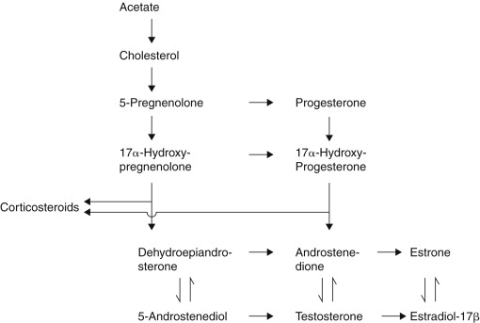
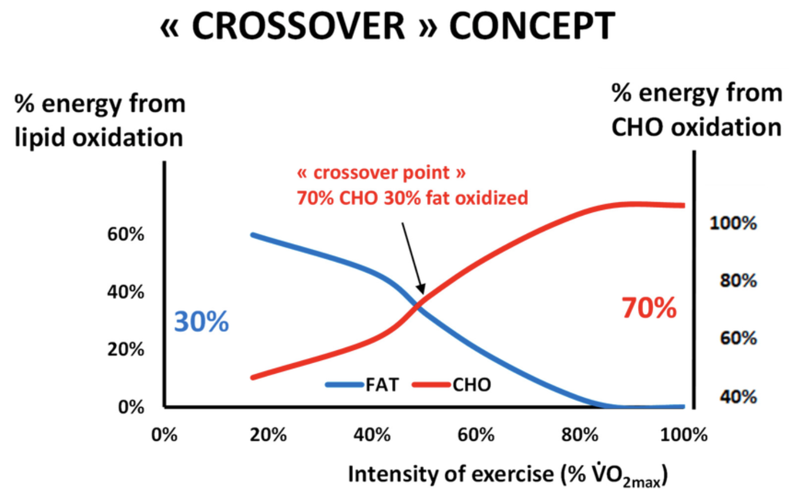
Fat
[13]Thomas DT, Erdman KA, Burke LM. Position of the Academy of Nutrition and Dietetics, Dietitians of Canada, and the American College of Sports Medicine: Nutrition and Athletic Performance. J Acad Nutr Diet. 2016 Mar;116(3):501-528.
[14] Jean FB, et al. Beyond the Calorie Paradigm: Taking into Account in Practice the Balance of Fat and Carbohydrate Oxidation during Exercise?, Nutrients. 2020 14(1605).
Notes:
Adequate healthy fat intake supports hormonal recovery, particularly estrogen regulation, which influences bone density and joint health. Endurance runners also rely on fat oxidation during longer training sessions. Therefore, 25–30% of total energy from fat provides the necessary hormonal support and energy stability without excess caloric surplus. This evidence-guided approach supports both performance and postpartum recovery.

Slide 19
Recommend
Avocado, olive oil, nuts, salmon
Meals: Salmon with brown rice, avocado sandwich, nuts + yoghurt
Avoid: Trans fats, too many fried foods,
In case to protect cardiovascular and weight management
25–30% of total kcal/day → ≈ 751–888 kcal/day（82–98 g/day）

Slide 20
4 Macronutrient prescription & Micronutrients
Calcium
Iron
Vitamin D
Folate(Vitamin B9)/Vitamin B12
Magnesium
Notes:
Key micronutrients often depleted postpartum:

Slide 21
Calcium
Valuable point ：
Postpartum women are in the recovery period of bone density With vitamin D to promote bone metabolism
Deficiency risks：
Loss of bone density, risk of osteoporosis due to irregular menstruation (common in female athletes) Stress fracture（mentioned in the general fitness course）
[15 ]Wahlquist, A. E., Blanke, H. H., Asghari, G., Baatz, J. E., Ebeling, M., Shary, J. R., Howard, C. R., Lawrence, R. A., Hollis, B. W., & Wagner, C. L. (2024). Factors Affecting Postpartum Bone Mineral Density in a Clinical Trial of Vitamin D Supplementation. Journal of women's health (2002), 33(7), 887–900.
Notes:
For this postpartum athlete, calcium supplementation is not just basic nutrition, but a core decision for injury prevention. Based on evidence from Wahlquist et al. (2024), postpartum women are in a critical window for bone density recovery. Given the athlete's current [high-impact training load], her skeletal system is under significant mechanical stress.
While we acknowledge postpartum physiology, the critical link here is that fluctuating estrogen levels, combined with potential irregular menstruation, significantly elevate the risk of stress fractures. This explains why I have prioritized the synergistic supplementation of Calcium and Vitamin D as a top nutritional priority.

Slide 22
Vitamin D
Valuable point：
Vitamin D supports bone health, which is particularly essential for postpartum women and endurance runners who experience high-impact loading.
Regulates immune function—important during postpartum recovery when immunity may be weakened.
Deficiency risks：
Muscle weakness, slower recovery
Mood disturbances (postpartum women are already vulnerable)
Notes:
Vitamin D enhances calcium absorption and supports neuromuscular function. Therefore, supplementation and dietary intake are prioritised.

Slide 23
Iron
Valuable point ：
Iron is a key component of haemoglobin and myoglobin and is essential for oxygen transport. Adequate iron levels optimise VO2 MAX, aerobic capacity, and fatigue resistance.
Deficiency risks：
Worsening of postpartum fatigue.
Risk of developing iron-deficiency anaemia if unaddressed.
[16]Keller, K., Friedrich, O., Treiber, J., Quermann, A., & Friedmann-Bette, B. (2024). Iron deficiency in athletes: Prevalence and impact on VO2 peak. Nutrition (Burbank, Los Angeles County, Calif.), 126, 112516.
Notes:
Iron deficiency reduces oxygen transport and VO2 max (Keller et al., 2024). As fatigue is already elevated postpartum, ensuring adequate iron is critical to maintain endurance performance. So the red meat would be really good choice here

Slide 24
Folate (Vitamin B9) / Vitamin B12
Valuable point：
Supports red blood cell production, directly related to endurance performance B vitamins are more likely to be deficient after pregnancy and breastfeeding
Deficiency risks：
Increased risk of anaemia Mood swings (common postpartum)
[17]Koury, M. J., & Ponka, P. (2004). New insights into erythropoiesis: the roles of folate, vitamin B12, and iron. Annual review of nutrition, 24, 105–131.
Notes:
Postpartum women often have lower B-vitamin status, which affects red blood cell function and energy metabolism (Koury & Ponka, 2004). This guides the inclusion of folate- and B12-rich foods.

Slide 25
Magnesium
Valuable point： Helps sleep quality Running for long periods of time can lead to a loss of magnesium through sweat
Deficiency risks：
Muscle cramps, fatigue Training adaptability becomes poor
[18]Luo, X., Tang, M., Wei, X., & Peng, Y. (2024). Association between magnesium deficiency score and sleep quality in adults: A population-based cross-sectional study. Journal of affective disorders, 358, 105–112.
Notes:
Magnesium supports sleep and reduces cramping, which directly addresses postpartum fatigue and muscle recovery needs. This justifies increasing magnesium-rich foods or supplementation.

Slide 26
5 Hydration strategy
Sweet Rate Test
Special Considerations for Postpartum Runners
Final hydration target
Notes:
Hydration needs are higher in postpartum athletes due to hormonal fluctuations, thermoregulation changes, and lactation-related fluid losses. Dehydration increases fatigue, heart rate, and perceived exertion. Therefore, sweat rate testing and structured hydration before, during, and after training are essential. This evidence-based approach protects both performance and milk production.

Slide 27
Sweat Rate Test
Weigh yourself before training
Run for 60 minutes (record water intake)
Weigh yourself after training
Notes:
Recommend a sweat-rate test: weigh before and after a 60-minute run, accounting for fluid intake.

Slide 28
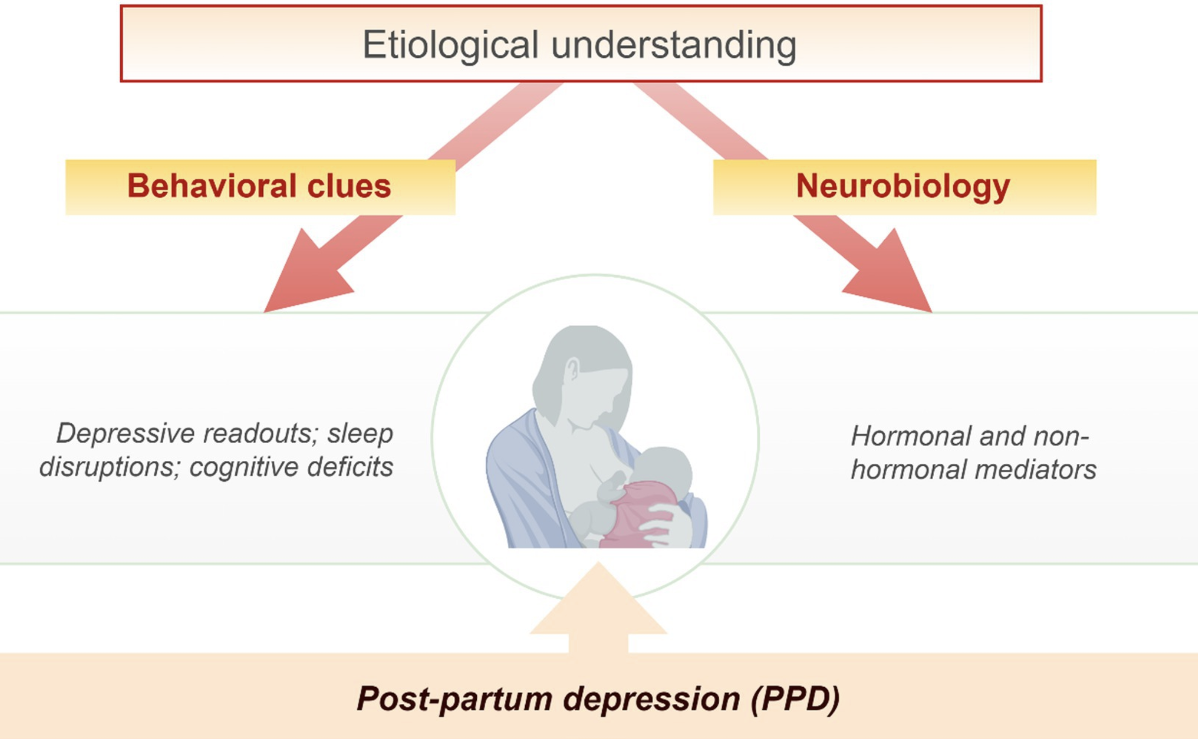
Special Considerations for Postpartum Runners
A. Postpartum fluid and hormone fluctuations
Unstable fluid regulation → more prone to dehydration Testosterone and estrogen levels do not recover → thermoregulation decreases
[20]Hendrick, V., Altshuler, L. L., & Suri, R. (1998). Hormonal changes in the postpartum and implications for postpartum depression. Psychosomatics, 39(2), 93–101.
Notes:
Postpartum hormonal fluctuations significantly influence hydration and thermoregulation. Evidence indicates that estrogen and testosterone remain suppressed for several months postpartum, which reduces thermoregulation efficiency and contributes to unstable fluid balance (Hendrick et al., 1998).
This means postpartum athletes are more prone to dehydration even at lower exercise intensities. When combined with increased metabolic demands from breastfeeding, the risk of fluid imbalance becomes higher than in non-postpartum athletes.
This evidence directly informs our hydration strategy. Because hormonal recovery is incomplete, hydration must be monitored more closely, with scheduled intake before, during, and after training. Therefore, the nutrition plan prioritises structured hydration and sweat-rate testing to prevent dehydration-induced fatigue and protect overall recovery.

Slide 29
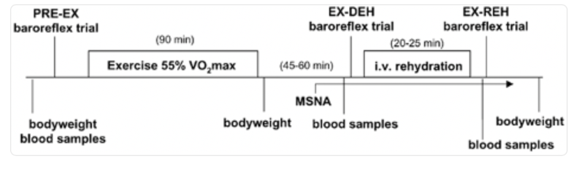
Special Considerations for Postpartum Runners
B. Postpartum fatigue is more likely to be amplified by dehydration
Mild dehydration causes: Abnormally high heart rate More irritating RPE (subjective fatigue sensation) Decreased movement speed Dizziness, headache
Each baroreflex trial consisted of 5 min of rest; then a bolus of sodium nitroprusside was administered, followed 1 min later by a bolus of phenylephrine.
[19]Charkoudian N, Halliwill JR, Morgan BJ, Eisenach JH, Joyner MJ. Influences of hydration on post-exercise cardiovascular control in humans. J Physiol. 2003;552(Pt 2):635-644.
Notes:
Research shows that even mild dehydration elevates heart rate, increases perceived exertion, slows movement speed, and causes dizziness (Charkoudian et al., 2003). For postpartum athletes, these effects are amplified because baseline fatigue is already elevated due to hormonal changes, disrupted sleep, and recovery demands.
This means dehydration has a disproportionately negative impact on postpartum runners compared with non-postpartum athletes. As a result, maintaining hydration is not only about performance but also about safety, perceived effort, and recovery efficiency.
Therefore, this evidence directly informs the recommendation for a structured hydration plan, including pre-run hydration, monitoring body weight changes, and ensuring fluid replacement post-exercise. This is particularly important to prevent postpartum fatigue escalation and protect training quality.

Slide 30
Final hydration target
Pre-hydration
During running
Post-run hydration
Notes:
Target: pale urine, 2.5–3 L total daily fluid, more on hot days with electrolytes. Dehydration amplifies fatigue, raises heart rate, and reduces performance."

Slide 31
6 Recovery strategy (4Rs)
1. Rehydrate
2. Refuel
3. Repair
4. Rest & Regeneration
Notes:
The 4R framework:

Slide 32
4R | What to do | Why important (postpartum runner)
Rehydrate | add electrolytes; extra fluids if breastfeeding | Unstable fluid regulation + more prone to dehydration + affects heart rate and recovery
Refuel | 1 g/kg carbs + 20–25 g protein within 30–60 min; carb periodisation | Supplement sugar and prevent fatigue; Support half marathon training
Repair | 1.4–1.6 g/kg/day protein, evenly distributed; night-time protein | Postpartum muscle and connective tissue repair is in high demand
Rest & Regenerate | Sleep 7–9 hours; naps; mobility; 80/20 training; foam rolling | Sleep deprivation + pelvic instability + increased risk of injury
Notes:
Postpartum recovery is influenced by sleep disruption, hormonal instability, and elevated fatigue. The 4Rs—rehydrate, refuel, repair, rest—directly address these challenges. Evidence supports the use of structured sleep hygiene, nutrient timing, and stress reduction practices to optimise recovery (Watson et al., 2015). These strategies help maintain training quality and reduce injury risk.

Slide 33
7.Ergogenic Aids
Why choose：
1. Nitrate / Beetroot
Why not choose：
1. Creatine
2. Sodium Bicarbonate

Slide 34
Nitrate / Beetroot
Running Economy:
Nitrate is converted into nitric oxide (NO) in the body, causing blood vessels to dilate, increasing blood flow to the muscles. More importantly, it reduces oxygen consumption by mitochondria during ATP production.
facts:
This means that the athlete consumes less oxygen and may have a lower heart rate when running at the same pace. This is valuable during the Base Conditioning phase, allowing her to build up her runs more efficiently.
[22]Bailey SJ, Winyard P, Vanhatalo A, Blackwell JR, Dimenna FJ, Wilkerson DP, Tarr J, Benjamin N, Jones AM. Dietary nitrate supplementation reduces the O2 cost of low-intensity exercise and enhances tolerance to high-intensity exercise in humans. J Appl Physiol (1985). 2009 Oct;107(4):1144-55.
Notes:
Recommended: Beetroot juice or nitrate supplementation. It improves running economy by reducing oxygen cost at a given pace—perfect for base building—and is considered safe during breastfeeding. This is especially valuable for a fatigued postpartum athlete returning to base conditioning.

Slide 35
Why not choose
Creatine | While creatine is helpful for postpartum recovery (pelvic floor muscles, cognitive function under sleep deprivation), it can lead to water retention (weight gain of 1-2kg). For a 66kg long-distance runner, the extra weight can increase joint stress.
[23]Hall M, Manetta E, Tupper K. Creatine Supplementation: An Update. Curr Sports Med Rep. 2021 Jul 1;20(7):338-344.
Notes:
Creatine can cause water retention and rapid weight fluctuations, which may be problematic for joint stability postpartum.

Slide 36
Why not choose
Sodium Bicarbonate | Not recommended. Baking soda is mainly used to buffer the acidic environment generated by high-intensity anaerobic exercise such as 800m - 3000m or interval running.
[24]Carr AJ, Slater GJ, Gore CJ, Dawson B, Burke LM. Effect of sodium bicarbonate on [HCO3-], pH, and gastrointestinal symptoms. Int J Sport Nutr Exerc Metab. 2011 Jun;21(3):189-94.
Notes:
About sodium bicarbonate.Firstly, the athlete's current stage is more inclined towards basic aerobic recovery, which is not in line with the applicable scenario of this supplement; Secondly, the postpartum digestive system may be more sensitive, and the common gastrointestinal discomfort and side effects of sodium bicarbonate may interfere with her normal training and postpartum recovery. At the current stage, the risk clearly exceeds the potential marginal benefits

Slide 37
7.Nutrition Across Contexts
1. For athletes (31-year-old women, endurance running, postpartum recovery), nutrition strategies must not be "one-size-fits-all". We need to introduce the concept of "nutritional periodisation" – "replenishing energy based on the amount of exercise needed".
2. Considering that she is 10-12 weeks postpartum, all strategies must be superimposed with a "recovery and lactation protective layer" to ensure that hormone recovery or milk production is not affected during caloric adjustments.
Notes:
Postpartum athletes require nutritional periodisation—adjusting intake based on training load—while protecting lactation and hormonal recovery. Therefore, strategies must not be “one-size-fits-all.” This evidence-based approach ensures her energy availability matches training intensity and physiological demands at each phase.

Slide 38
dimension | Rest Day | Training Day (Current Phase: Cardio Foundation Building) | Race Day (Race Day) (10km / Half Marathon)
Main objectives: | Deep recovery, control of inflammation, replenishment of trace elements. | Ensure training quality, optimize glycogen reserves, and recover quickly after exercise. | There are only two goals: maximum performance & gastrointestinal comfort.
carbohydrates | Low - Medium (3-4 g/kg) Focus on high-fiber, low-GI foods (whole grains, lots of vegetables). | Medium - High (5-7 g/kg) Around intake before and after training. Eating extra meals after exercise is essential. | High (Pre-Race Meal) Choose low-fibre, easily digestible carbohydrates (white bread, bananas, sports drinks).
protein | Stable (1.6-2.0 g/kg) Approximately 20-30g per meal, evenly distributed throughout the day, to prevent muscle loss. | Stay stable The focus is on consuming 20g of high-quality protein within 30 minutes of exercise. | moderate eat a small amount of pre-race meals to avoid excessive satiety; Replenishment is required immediately after the game.
fat | Moderate increase As the main source of satiety (avocado, nuts, fish oil)。 | Medium Avoid eating too much fat 1-2 hours before training to avoid indigestion. | Very low (pre-race) Try to avoid fat 2-3 hours before the race in case of gastrointestinal upset during the race.
Pay special attention after childbirth | Don't over-diet. Even on rest days, if you are breastfeeding, you still need about 300-500kcal extra. | Hydration Postpartum sweating rates may change, and lactation consumes water, requiring additional attention to urine color. | As mentioned earlier, caffeine intake on game days should be combined with a lactation schedule.
Notes:
Rest days: 3–4 g/kg carbs (high-fiber, low-GI), stable protein, moderate fat increase. Never restrict calories aggressively while breastfeeding. Training days: 5–7 g/kg carbs focused around sessions, quick post-training recovery. Race days: High, low-fiber, easily digestible carbs; very low fat pre-race for GI comfort. All plans include a protective layer for lactation and hormonal recovery.

Slide 39
Sample 1-Day Menu

Slide 40
Time | Phase | Food & Fluid | Key Action Items | Log
07:30 | Breakfast | 🥣 Oatmeal (boiled in milk/soy milk) + chia seeds 🥚 2 hard-boiled eggs 🫐 Blueberries/strawberries | ✅ Make sure to consume protein and calcium ✅ Avoid being too greasy to prevent slow digestion | Appetite: ⭐⭐⭐⭐⭐
09:00 | Eat before practice (Supplement) | 🍞 1 slice of white toast+ Jam / honey 🥤 Supplement B: 1 bottle of beetroot juice (70ml) | ⚠️ Postpartum Notes: Due to breastfeeding, caffeine should be banned | Heart rate/anxiety： __________
10:00 | In training (60min Base) | 💧 Drink water only (on demand) (If the weather is extremely hot, electrolyte tablets can be added) | 🚫 No solid food required ✅ Feel the state of the body, especially the pelvic floor muscles | RPE (Tired1-10): __________
11:30 | Lunch after practice (Gold recovery) | 🍚 Recovery Bowl: Rice (carbs) + Chicken breast/fish (egg white) + Spinach (iron) 🍊 Serve with: Orange or drizzle lemon juice (to help iron absorption) | ✅ Replenish the water lost after running This meal should be the richest in carbohydrates to help glycogen backfill。 | Post-run weight: __________

Slide 41
Time | Phase | Food & Fluid | Nutrient Focus | Record
15:00 | Afternoon meal (depending on hunger) | 🥛 yogurt or a small handful of nuts 💧 Hydration: Carry a water bottle with you | ✅ Calcium Supplementation (Bone Health) ✅ Maintain water requirements during lactation | Afternoon mental state:⭐⭐⭐⭐⭐
18:30 | Dinner (Repair and satiety) | 🍠 potato/pumpkin (quality whole grain) 🥩 Lean beef (red meat for iron!) 🥦 Leafy greens (cellulose) | ✅ Heme iron (to combat postpartum anemia risk) ✅ High protein (muscle synthesis) ✅ High fiber (gut health) | Dinner satiety: __________
All day | Moisture summary | 💧 Total target volume: approx. 2.5 - 3.0 liters | Observe whether the urine is yellowish in color | Urine color up to standard? ☐Yes ☐ No
22:00 | Evening remarks | (If extremely hungry, drink half a glass of hot milk before going to bed) | 🛌 Sleep | Today's sleep duration: __________ hours

Slide 42
summary
The plan emphasises fueling for dual roles (athlete and breastfeeding mother) to prevent RED-S, restore micronutrients, support bone/muscle recovery, and enable a safe and sustainable return to competitive endurance running. Strategies prioritise periodized fueling, hydration, recovery, and safe supplementation to optimise performance, health, and injury prevention without compromising postpartum physiology.
Notes:
"In summary: We’ve designed a plan that fuels her dual roles—athlete and breastfeeding mother—at ~2950 kcal to prevent RED-S. Targeted micronutrient restoration supports bone health and energy. Periodized fueling matches training demands while protecting lactation. Safe use of beetroot juice enhances running economy. The outcome: a sustainable return to 10 km/half-marathon performance with reduced injury risk, better recovery, and maintained hormonal and milk supply health.

Slide 43
Reference
[1]Dietz, P., Legat, L., Sattler, M.C. et al. Triple careers of athletes: exploring the challenges of planning a pregnancy among female elite athletes using semi-structured interviews. BMC Pregnancy Childbirth 22, 643 (2022).
[2]Bijlholt, Margriet et al. “Evolution of Postpartum Weight and Body Composition after Excessive Gestational Weight Gain: The Role of Lifestyle Behaviors-Data from the INTER-ACT Control Group.” International journal of environmental research and public health vol. 18,12 6344. 11 Jun. 2021.
[3]Mariman, An et al. “Longitudinal assessment of sleep and fatigue according to baby feeding method in postpartum women: a prospective observational study.” BMC pregnancy and childbirth vol. 24,1 529. 12 Aug. 2024.
[4]Jiang, J., Li, C.el al. (2024) ‘Relationship between abnormal pelvic floor electromyography and obstetric factors in postpartum women: a cross-sectional study’, BMC Women’s Health, 24, p. 239.
[5]Baattaiah BA, Zedan HS,et al. Physical activity patterns among women during the postpartum period: an insight into the potential impact of perceived fatigue. BMC Pregnancy Childbirth. 2022 Sep 3;22(1):678.
[6]Pengelly, Michael et al. “Iron deficiency, supplementation, and sports performance in female athletes: A systematic review.” Journal of sport and health science, vol. 14 101009. 12 Nov. 2024,
[7]Holtzman B, Ackerman KE. Recommendations and Nutritional Considerations for Female Athletes: Health and Performance. Sports Med. 2021;51(Suppl 1):43-57.
[8]Jin, Ying et al. “Prevalence of thyroid dysfunction in postpartum women with suboptimal iodine and selenium and adequate iron status.” Clinical endocrinology vol. 95,6 (2021): 873-881.
[9]Dewey, K G. “Energy and protein requirements during lactation.” Annual review of nutrition vol. 17 (1997): 19-36. doi:10.1146/annurev.nutr.17.1.19
[10] Burke, L. M., Hawley, J. A., Wong, S. H., & Jeukendrup, A. E. (2011). Carbohydrates for training and competition. Journal of sports sciences, 29 Suppl 1, S17–S27.

Slide 44
Reference
[11]Butte, N. F., & King, J. C. (2005). Energy requirements during pregnancy and lactation. Public health nutrition, 8(7A), 1010–1027.
[12]Thomas, D Travis et al. “Position of the Academy of Nutrition and Dietetics, Dietitians of Canada, and the American College of Sports Medicine: Nutrition and Athletic Performance.” Journal of the Academy of Nutrition and Dietetics vol. 116,3 (2016): 501-528.
[13]Thomas DT, Erdman KA, Burke LM. Position of the Academy of Nutrition and Dietetics, Dietitians of Canada, and the American College of Sports Medicine: Nutrition and Athletic Performance. J Acad Nutr Diet. 2016 Mar;116(3):501-528. doi: 10.1016/j.jand.2015.12.006. Erratum in: J Acad Nutr Diet. 2017 Jan;117(1):146.
[14] Jean FB, et al.Beyond the Calorie Paradigm: Taking into Account in Practice the Balance of Fat and Carbohydrate Oxidation during Exercise?, Nutrients. 2020 14(1605).
[15 ]Wahlquist, A. E., Blanke, H. H., Asghari, G., Baatz, J. E., Ebeling, M., Shary, J. R., Howard, C. R., Lawrence, R. A., Hollis, B. W., & Wagner, C. L. (2024). Factors Affecting Postpartum Bone Mineral Density in a Clinical Trial of Vitamin D Supplementation. Journal of women's health (2002), 33(7), 887–900.
[16]Keller, K., Friedrich, O., Treiber, J., Quermann, A., & Friedmann-Bette, B. (2024). Iron deficiency in athletes: Prevalence and impact on VO2 peak. Nutrition (Burbank, Los Angeles County, Calif.), 126, 112516.
[17]Koury, M. J., & Ponka, P. (2004). New insights into erythropoiesis: the roles of folate, vitamin B12, and iron. Annual review of nutrition, 24, 105–131.
[18]Luo, X., Tang, M., Wei, X., & Peng, Y. (2024). Association between magnesium deficiency score and sleep quality in adults: A population-based cross-sectional study. Journal of affective disorders, 358, 105–112.
[19]Charkoudian N, Halliwill JR, Morgan BJ, Eisenach JH, Joyner MJ. Influences of hydration on post-exercise cardiovascular control in humans. J Physiol. 2003;552(Pt 2):635-644.
[20]Hendrick, V., Altshuler, L. L., & Suri, R. (1998). Hormonal changes in the postpartum and implications for postpartum depression. Psychosomatics, 39(2), 93–101.
[21]Watson NF, Badr MS, Belenky G, Bliwise DL, Buxton OM, Buysse D, Dinges DF, Gangwisch J, Grandner MA, Kushida C, Malhotra RK, Martin JL, Patel SR, Quan SF, Tasali E. Recommended Amount of Sleep for a Healthy Adult: A Joint Consensus Statement of the American Academy of Sleep Medicine and Sleep Research Society. Sleep. 2015 Jun 1;38(6):843-4. 、

Slide 45
Reference
[22]Bailey SJ, Winyard P, Vanhatalo A, Blackwell JR, Dimenna FJ, Wilkerson DP, Tarr J, Benjamin N, Jones AM. Dietary nitrate supplementation reduces the O2 cost of low-intensity exercise and enhances tolerance to high-intensity exercise in humans. J Appl Physiol (1985). 2009 Oct;107(4):1144-55.
[23]Hall M, Manetta E, Tupper K. Creatine Supplementation: An Update. Curr Sports Med Rep. 2021 Jul 1;20(7):338-344.
[24]Carr AJ, Slater GJ, Gore CJ, Dawson B, Burke LM. Effect of sodium bicarbonate on [HCO3-], pH, and gastrointestinal symptoms. Int J Sport Nutr Exerc Metab. 2011 Jun;21(3):189-94.

Slide 46
Thank you

